Slide 1


Mark R. Cutkosky
Stanford University 3 June 2013
Part I: Monday, 3 June @11:00
tactile sensing in nature
What is tactile sensing?
How is it used?
in humans? in animals?
What exactly is being measured?
What insights can we draw for robotic tactile sensing in medical and related applications?
Part II: Thursday, 6 June @14:00
basic issues, mechanics and trade-offs in tactile sensing
Part III: Monday, 10 June @11:00
implementations and applications
Notes:
My name is Santhi Elayaperumal, I am speaking on MRI-Compatible Haptics…using strain sensing to predict 3-dimensional needle bending in real-time.

Slide 2
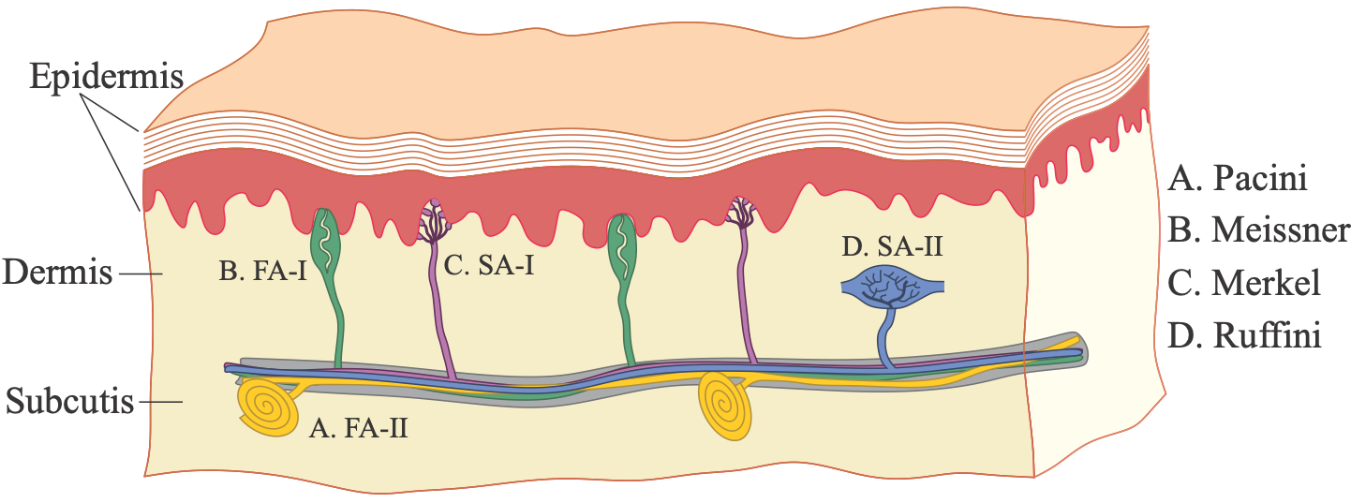
Human mechanoreceptors
Cutkosky M.R. and Ulmen, J., “Dynamic tactile sensing,” in The Human Hand: A Source of Inspiration for Robotic Hands, R. Balasubrmanian and V. Santos, eds., Springer Verlag (in press).
Receptor | receptive field | frequency range | sensed quantity
FA-I Meissner corpuscles 140/cm^2 1cmcm^2cmfingertips | 3-4mm | 5-60 Hz | dynamic skin deformation
SA-I Merkel endings 70/cm^2 | 3-4mm | 0-5 Hz | compressive stresses
FA-II Pacini corpuscles | >20mm | 50-500+ Hz (peak sensitivity ~250 Hz) | vibration
SA-II Ruffini endings | >10mm | 0-10 Hz | directional skin stretch
table data from various sources (see Johansson & Flanagan 2009 for review)

Slide 3
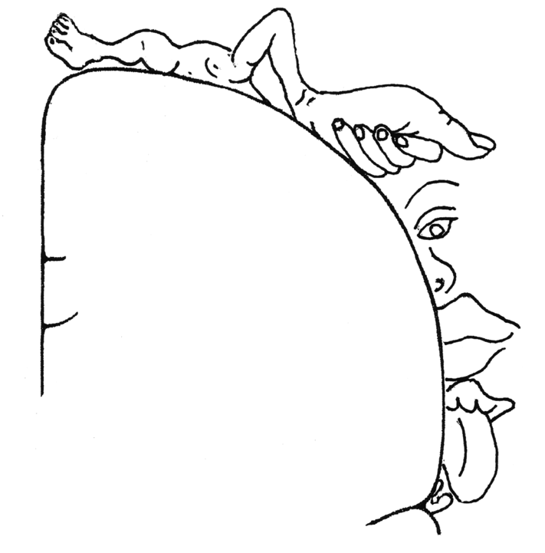
Start with some
hands-on
exercises
Cortical homunculus
Wilder Penfield ~1950
Notes:
My name is Santhi Elayaperumal, I am speaking on MRI-Compatible Haptics…using strain sensing to predict 3-dimensional needle bending in real-time.

Slide 4
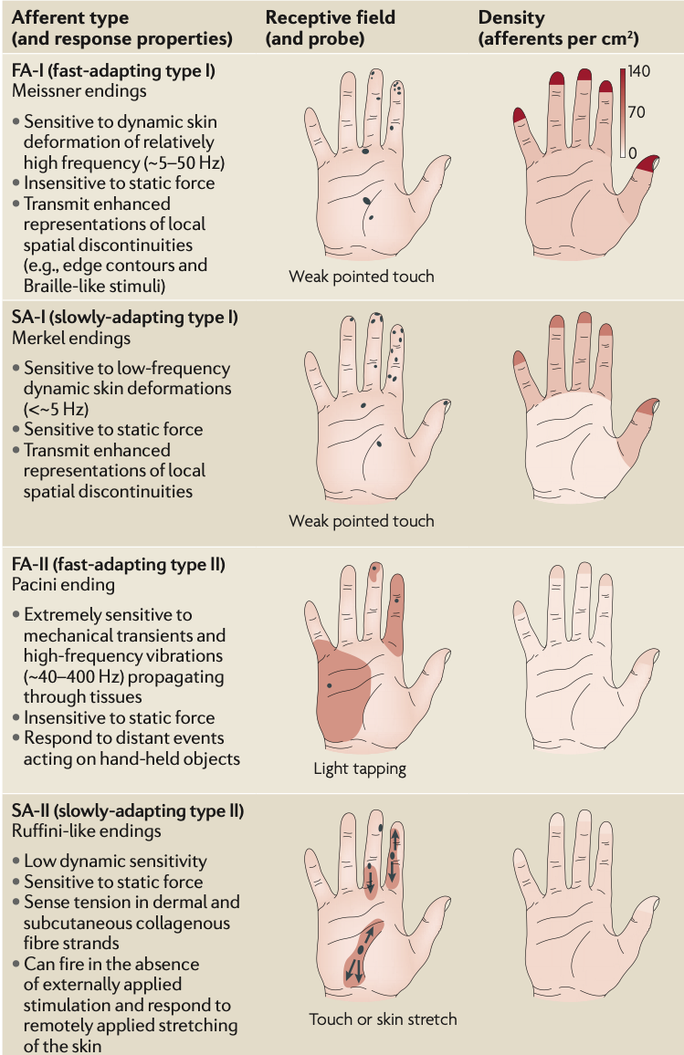
Mapping
mechanoreceptors
Johansson, R.S. and Flanagan, J.R.,
Coding and use of tactile signals
from the fingertips in object
manipulation tasks, Nature Reviews,
Vol. 10, May 2009, 345-357

Slide 5
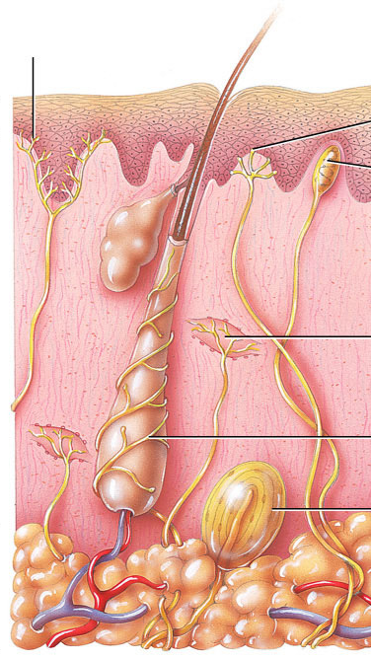
Thermal sensing
free nerve endings
for temperature, pain
separate warm and cold receptors whose firing rate depends on magnitude of difference w.r.t body temperature
both slowly adapting (SA) and rapidly adapting (FA) characteristics, so depends on both T and dT/dt
perception strongly affected by body temperature versus temperature at surface of skin (aluminum feels cooler at room temperature than wood) -- an important component of material identification
R.K. Adair. A model of the detection of warmth and cold by cutaneous sensors through effects on voltage-gated membrane channels, PNAS 1999 96 (21).

Slide 6
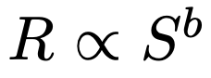
Resolution
~ 17,000 mechanoreceptors in human hand
(>100,000 in star nosed mole, 6 along body in C. elegans respond to 10μN force)
Spacing of afferents at fingertips to 140/cm² for FA-I; 0.7mm mean spacing; receptive fields ~ 11mm².
Resolution: two-point discrimination = 1-2 mm
Gratings with spacings to approximately 1mm (finer spacing = “texture”)
Discrete bumps on smooth surfaces down to a few microns (e.g. checking imperfections in paint)
Nonlinear neural response: where R = response, S = stimulus magnitude, b ~ 0.7, which increases dynamic range.
However, subjects often report almost linear perception to varying stimuli.

Slide 7
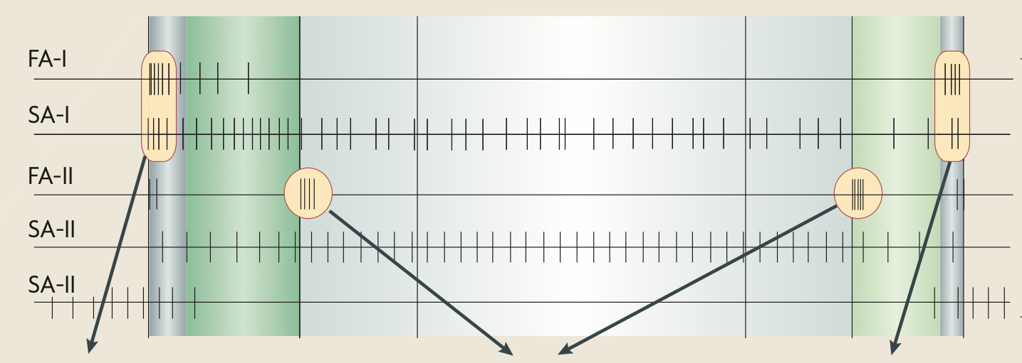
Tactile events in manipulation tasks
fingers
contact
object
object makes
or breaks
contact with
surface
contact
released
Johansson, R.S. and Flanagan, J.R., Coding and use of tactile signals
from the fingertips in object manipulation tasks, Nature Reviews,
Vol. 10, May 2009, 345-357

Slide 8
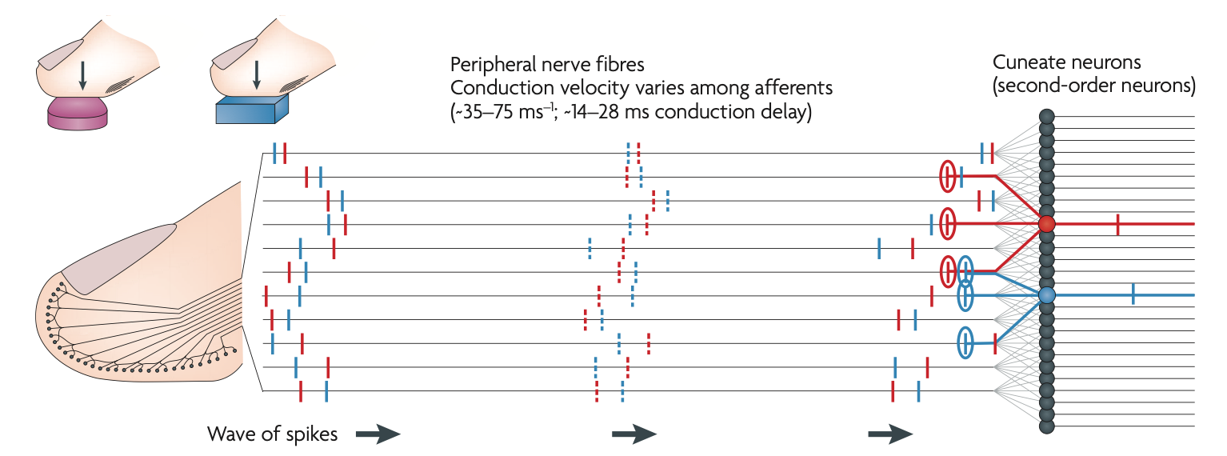
Timing and coincidence
curved
flat
Although nerve conduction is slow and spike frequency is moderate
(~100/sec maximum), timing of first spikes can be interpreted
at peripheral nerves to give cues about loading sequence.
Johansson, R.S. and Flanagan, J.R., Coding and use of tactile signals
from the fingertips in object manipulation tasks, Nature Reviews,
Vol. 10, May 2009, 345-357

Slide 9
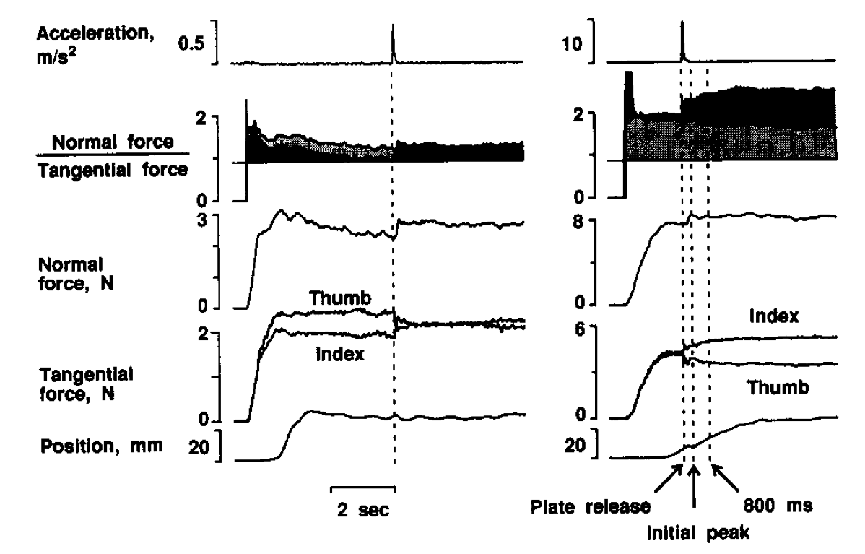
Grasp force regulation is based on slips and
incipient slips
spontaneous slip: adjustment in ~80 ms
artificially induced slips - subjects did not habituate
B. Edin, R.D. Howe, G. Westling and M.R. Cutkosky, "Relaying Frictional Information to a Human Operator by Physiological Mechanisms," IEEE Transactions on Systems, Man, and Cybernetics, Vol. 23, No. 2, March/April 1993, pp. 427-432.

Slide 10
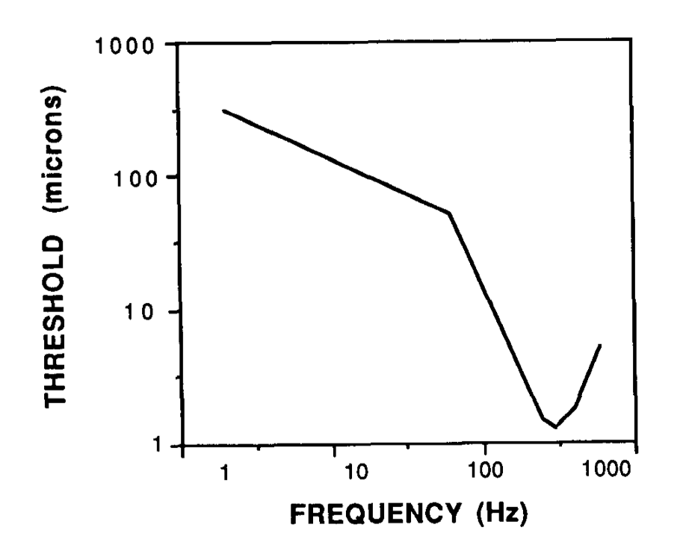
Pacinian corpuscle (FA-II) sensitivity to vibrations and Meissner (FA-I) sensitivity to small features
Peak sensitivity
around 300 Hz.
Able to detect
bumps of a few
microns under
ideal conditions
Adapted from data in Verrillo, R.T., Vibrotactile thresholds measured at the finger, Perception & Psychophysics, Vol. 9 (4) (1971).

Slide 11
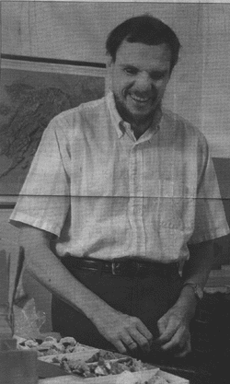
Haptic exploration and integration
Interview with blind field paleontologist Professor G.J. Vermeij, U.C. Davis Geophysics Dept.
http://www-cdr.stanford.edu/dml/previous_projects/vermeij/vermeij.html
Cutkosky & Costa 1995
Topics
Scales of space and time for exploration
Object recognition
Effects of cold
Exploratory procedures
Integration of information
http://www-cdr.stanford.edu/dml/previous_projects/vermeij/vermeij.html#seperate

Slide 12
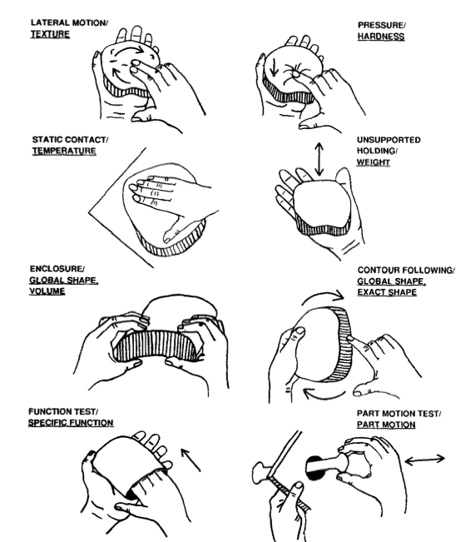
EPs:
Exploratory
Procedures
Lederman, S. and Klatzky, B.
Extracting object properties through
haptic exploration,
Acta Psychologica 84 (1993)
29-40.

Slide 13
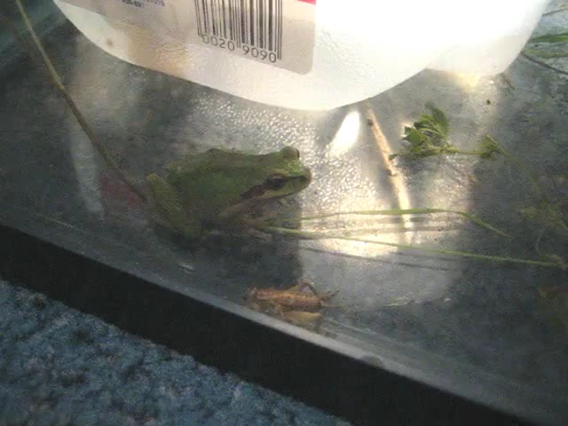
Anuran (frog) tactile responses
Tactile sensing triggers stereotypical responses [1-3]
Some evidence of primitive goals or “funnels” [4]:
Make any kind of contact, as soon as possible
Use both hands to pull on any graspable features
Bring object toward center of the manipulable workspace
Bring toward mouth
If something doesn’t work at first…
Keep trying!
Frogs grasping crickets (15 FPS) - A. Asbeck
[1] Gray, L.A. et al., Evolution of Forelimb Forelimb Movement Patterns for Prey Manipulation in Anurans, J. Exp. Zoology, 277:417–424 (1997)
[2] Comer, C. and Grobstein, P., Tactually Elicited Prey Acquisition Behavior in the Frog, Rana pipiens, and Comparison with Visually Elicited Behavior J Comp Physiol (1981) 142:141-150
[3] Ivanco, T.L. et al., Skilled forelimb movements in prey catching and in reaching by rats and opossums, Behavioural Brain Research, 79 (1996) 163-181
[4] Rizzi, A. et al., Sequential Composition of Dynamically Dexterous Robot Behaviors, IJRR 1999; 18; 534.

Slide 14

Anuran (frog) tactile responses
Tactile sensing triggers stereotypical responses [1-3]
Some evidence of primitive goals or “funnels” [4]:
Make any kind of contact, as soon as possible
Use both hands to pull on any graspable features
Bring object toward center of the manipulable workspace
Bring toward mouth
If something doesn’t work at first…
Keep trying!
Frogs grasping crickets (3 FPS) - A. Asbeck
[1] Gray, L.A. et al., Evolution of Forelimb Forelimb Movement Patterns for Prey Manipulation in Anurans, J. Exp. Zoology, 277:417–424 (1997)
[2] Comer, C. and Grobstein, P., Tactually Elicited Prey Acquisition Behavior in the Frog, Rana pipiens, and Comparison with Visually Elicited Behavior J Comp Physiol (1981) 142:141-150
[3] Ivanco, T.L. et al., Skilled forelimb movements in prey catching and in reaching by rats and opossums, Behavioural Brain Research, 79 (1996) 163-181
[4] Rizzi, A. et al., Sequential Composition of Dynamically Dexterous Robot Behaviors, IJRR 1999; 18; 534.

Slide 15
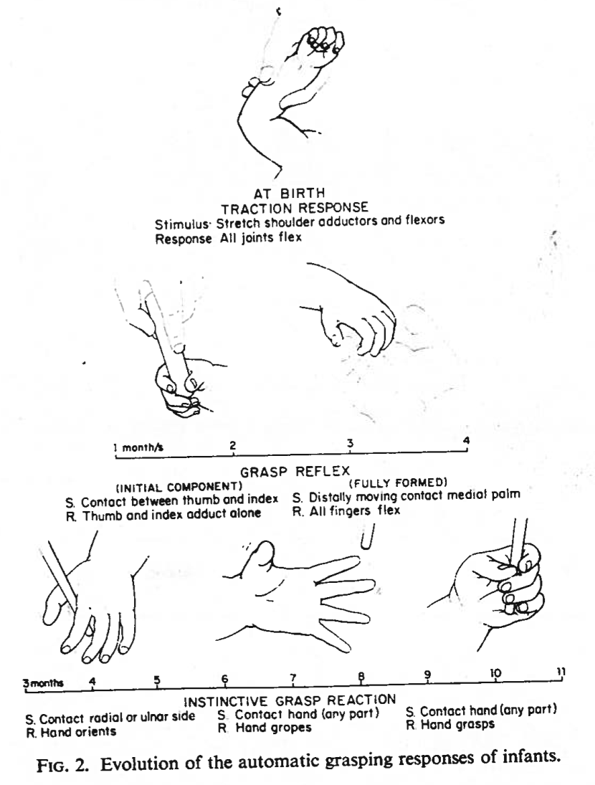
Grasping and sensing reflexes are used to monitor normal infant development.
Twitchel, T.E, The Automatic grasping responses of infants,
Neuropsycholgia, Vol. 3, pp. 247-259 1965.

Slide 16
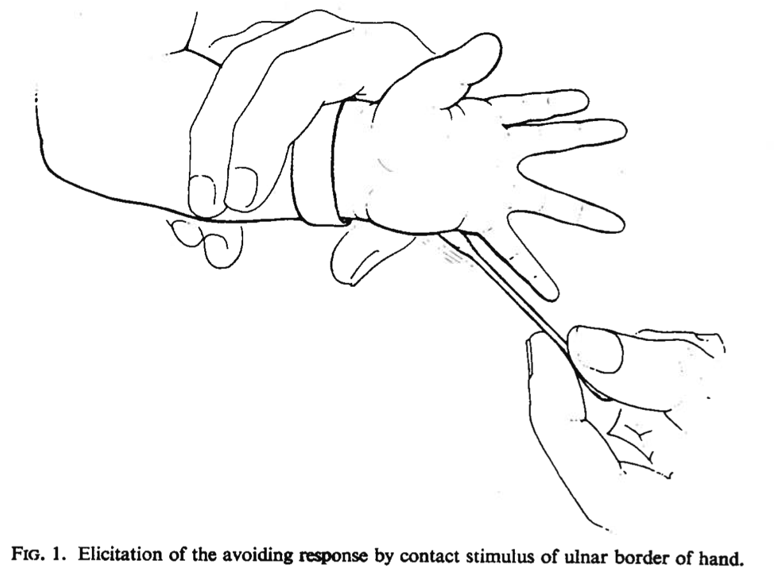
Avoidance
Twitchel, T.E, The Automatic grasping responses of infants,
Neuropsycholgia, Vol. 3, pp. 247-259 1965.

Slide 17
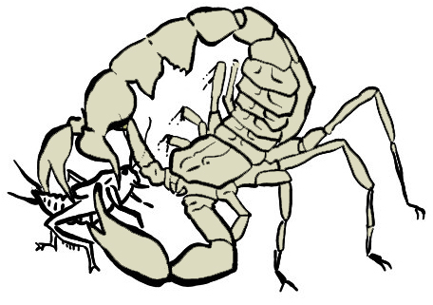
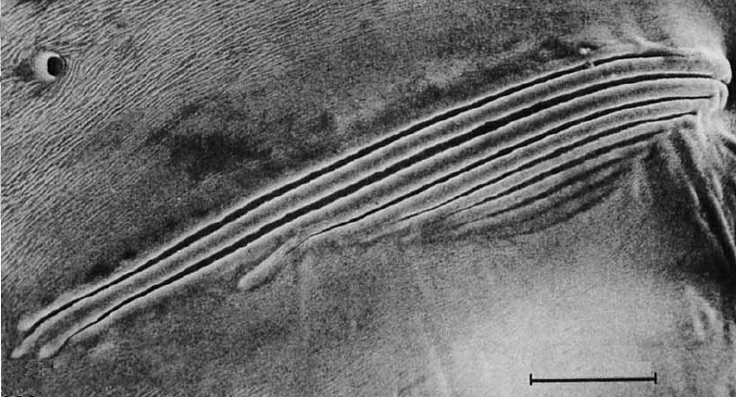
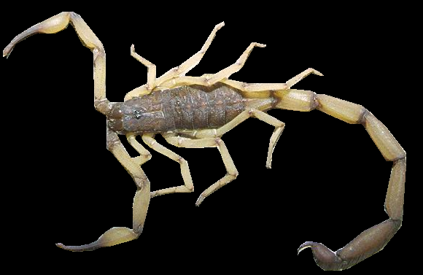
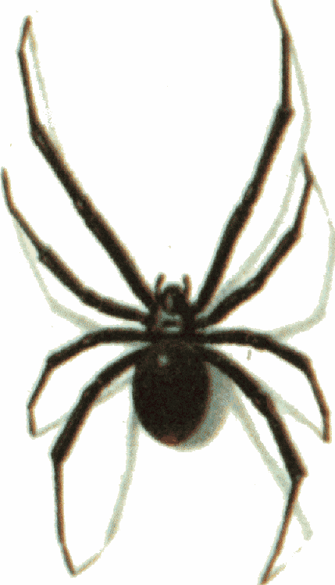
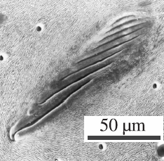
Other biological exemplars
[1]
Slit sense organs
Scorpion: 76 / leg
Spider: 224 / leg
Senses strains on the leg
Exoskeleton structures make the sensors possible (intrinsic tactile sensing)
Able to sense forces applied to areas elsewhere on the leg
Used in prey location - timing of spikes for 50m/s Rayleigh waves, ~300 Hz
Additional hair sensors give contact locations
10 μm
[2]
[1] F. G. Barth and M. Wadepuhl. Slit Sense Organs on the Scorpion Leg. Journal of Morphology, 145 (2): 209-227, 1975
[2] F. G. Barth and J. Stagl. The Slit Sense Organs Arachids. Zoomorphologie, 86:1-23, 1976
[3] W. Sturzl, R. Kempter, J.L. van Hemmen, Theory of Arachnid Prey Localization, Physical Review Letters, v. 84, n. 4, June 2000.

Slide 18
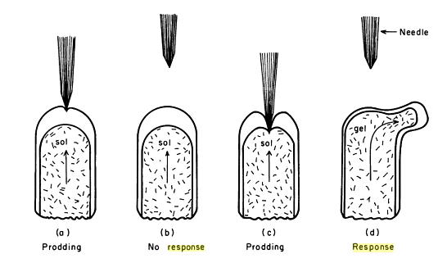
Amoeba touch response
hyaline
layer
membrane
granular
cytoplasm
I. Joan Lorch, Cha 1, in The Biology of the Amoeba,
Kwang Jeon, ed., Academic Press, NY, 1973.

